Slide 1
An Optimized AMPM-based Prefetcher Coupled with Configurable Cache Line Sizing
Qi Jia, Maulik Bakulbhai Padia, Kashyap Amboju and Huiyang Zhou
Department of Electrical and Computer Engineering
North Carolina State University

Slide 2
Presentation Outline
Access Map Pattern Matching (AMPM) Prefetcher
Problems with AMPM
Cold zone
Inaccurate states within zones
Proposed Optimizations
Configurable Block Sizing (CBS)
Two-Level Prefetching
Hardware Overhead
Experimental Results
Conclusion

Slide 3
AMPM
Access
0xAAFF
Init/0
Access/2
0xAB00
Access 1
0xAB01
0xAB02
Access 2
0xAB03
Current access
Prefetch
Access
0xAB04
Access 3
0xAB05
Pre-
Fetch/1
0xAB06
Prefetch
・・・
0xABFF
Cache Line
・・・

Slide 4
Problems with AMPM
Cold Zone
No Pattern is detected before the zone bitmaps is evicted from the zone table
No pattern detected
Last Access before zone eviction
… … | 0 | 2 | 0 | 2 | 0 | … … | 0 | 2 | 2
… … | 0 | 0 | 0 | 0 | 0 | … … | 0 | 0 | 0
0x480
0x4c0
0x500
0x540
0x580
0x9c0
0xa00
0xa40

Slide 5
Problems with AMPM Cont.
Inaccurate States in Zone
The bits in zone bitmaps cannot reflect the actual states. (i.e. block evictions)
Bitmap indicate “Access”, but is evicted previously
Cannot prefetch since AMPM treat it as accessed and assumes it remain in cache.
Prefetch Chance Lost!!!
Access
… … | 2 | 2 | 2 | 2 | 0 | … … | 2 | 1 | 1
… … | 2 | 2 | 2 | “2” | 0 | … … | 2 | 1 | 1
0x480
0x4c0
0x500
0x540
0x580
0x9c0
0xa00
0xa40

Slide 6
Proposed Optimizations
Common Offset Table (COT)
Record the most frequent accessed
offsets across different pages
Update on every demand access
Only init prefetch from COT when
COT gets high accuracy
Access map page 1
… … | 1 | 2 | 2 | 1 | 0 | … …
Pref | Counter | Offset | LRU
Common Offset Table
… … | 0 | 1 | 2 | 1 | 0 | … …
Access map page 2
… … | 0 | 1 | 2 | 2 | 0 | … …
Notes:
Threshold : 5

Slide 7
Proposed Optimizations Cont.
Conflict Table
Record how inaccurate the current information is
Each entry in the table is corresponding to one page
The entry counter will be increased when
inaccuracy is detected.
The entry counter will be reset when the page
is evicted out
Cache miss
Access map page
… … | 0 | 1 | 2 | 2 | 0 | … …
3
1
7
… …
4
3
1
8
… …
4
update
Conflict Table
Notes:
Threshold : 12

Slide 8
Configurable Cache Line Sizing
A block size monitor is used to select the best block size used for LLC.
Block size selection algorithm (consider bandwidth and performance)
Score = hit – A * (access – hit) * block_size
The selected blk size will be used to
guide the LLC prefetch.

Slide 9
Two-Level Prefetching
Specific for DPC2 framework.
Change the state “Prefetch” in access map to “L2 Prefetch” and “LLC Prefetch”.
Our main goal is to hide long main memory latency. And then try to hide the LLC latency.
During prefetch candidate selection, we will first choose the blocks which are not prefetched. If the such candidates do not fill up the prefetch degree we will choose the blocks which are in “LLC prefetch” to transfer them into L2 cache.

Slide 10
Hardware Overhead
Components |  |  | Storage
Memory Access Map Table | Address Tag (64 b) LRU (6 b) Access Map (3*64 b) | 64 entries | 2.047KB
CBS monitor | ATD | 4 ATD | 2.872KB
Common Offset Table | Counter (6 b) LRU status (6 bits) Offset Map(64*6 bits +64*1bit) | 8 entries | 0.45KB
Conflict Table | Counter (6 bits) | 64 entries | 0.046KB
Prefetch Bit | Prefetch (1 bit) | 4096 blks | 0.5KB
Cold Zone MSHR | Tags (64 bits) LRU status (5 bits) | 32 entries | 0.27KB
Total |  |  | 6.185KB

Slide 11
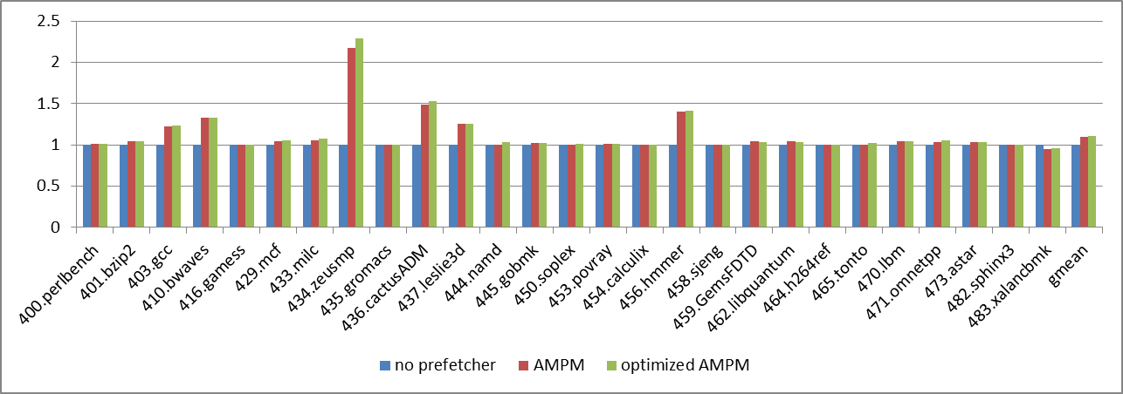
Experimental Results
The optimized prefetcher outperforms the baseline without prefetching by 10.8%. Compared with the original AMPM, it achieves a speedup of 0.76% on average

Slide 12
Conclusions
We optimize the AMPM prefetcher by introducing two hardware components: common offset table and conflict table.
We combine the AMPM prefetcher with configurable block sizing and two-level prefetching mechnisim.

Slide 13
Question

