Slide 1
Variable Length Delta Prefetcher
Manjunath Shevgoor, Sahil Koladiya, Rajeev Balasubramonian,
University of Utah
Zeshan Chishti
Intel Labs
Notes:
Prefetching is a well studied field. The fact that this is the second DPC should tell us how much work exists in the field.
However we still see interesting developments in the field every year.
In recent years, the frequency gap between between the core and DRAM may not have increased much but increasing core counts have resulted in increased memory traffic.
Prefetching is one of the ways to address the problem of high memory latency.
Prefetching no longer means just prefetching into the L1 cache. Prefetchers may be deployed between an off chip L4 and L3.
In a heterogeneous system, it may mean prefetching from the NVM level to the DRAM level.
For all these reason, prefetching remains and interesting and important area of research

Slide 2
Prefetchers
Confirmation Based Prefetchers
Issue predictions after a few deltas
High Accuracy
Short Streams Lose out
Immediate Prefetchers
Aggressive
Low Accuracy
Waste precious DRAM bandwidth and cache capacity
Notes:
I will first talk about some of the types of prefetchers that exist today. Before going into the details of VLDP
They wait a couple of deltas before issuing prefetches.

Slide 3
Spatial Correlation
Learn Access (Delta) Patterns
Apply patterns when similar conditions re-occur
Delta Patterns
Regular Delta Patterns. Eg: ( +1, +1, +1)…, (+2, +2, +2, +2)…
Irregular Delta Patterns. Eg: ( +1, +2, +3 )…
Notes:
Most prefetchers try to learn the dominant access patterns that exist in the application and make predictions based on these insights.
Prefetchers that use Spatial Correlation use the access to certain cache lines to predict that other cache lines will be used in the near future, because last time this was the sequence of cache line accesses.
This is useful when the application frequently accesses some data structure.
The kinds of access patterns that are seen can be classified into UDP and NUDP.
RDPs are typical of data structures like loops.
IRDPS occur when large structures or nested structures are accessed. The order in which the different members of the structure are accessed will dictate the delta patterns.
There are many prefetchers which do very well recognizing and predicting RDPs. Stream prefetchers, SandBox Prefetcher etc will all do very well.
There are no many prefetchers which do well with IDPs

Slide 4
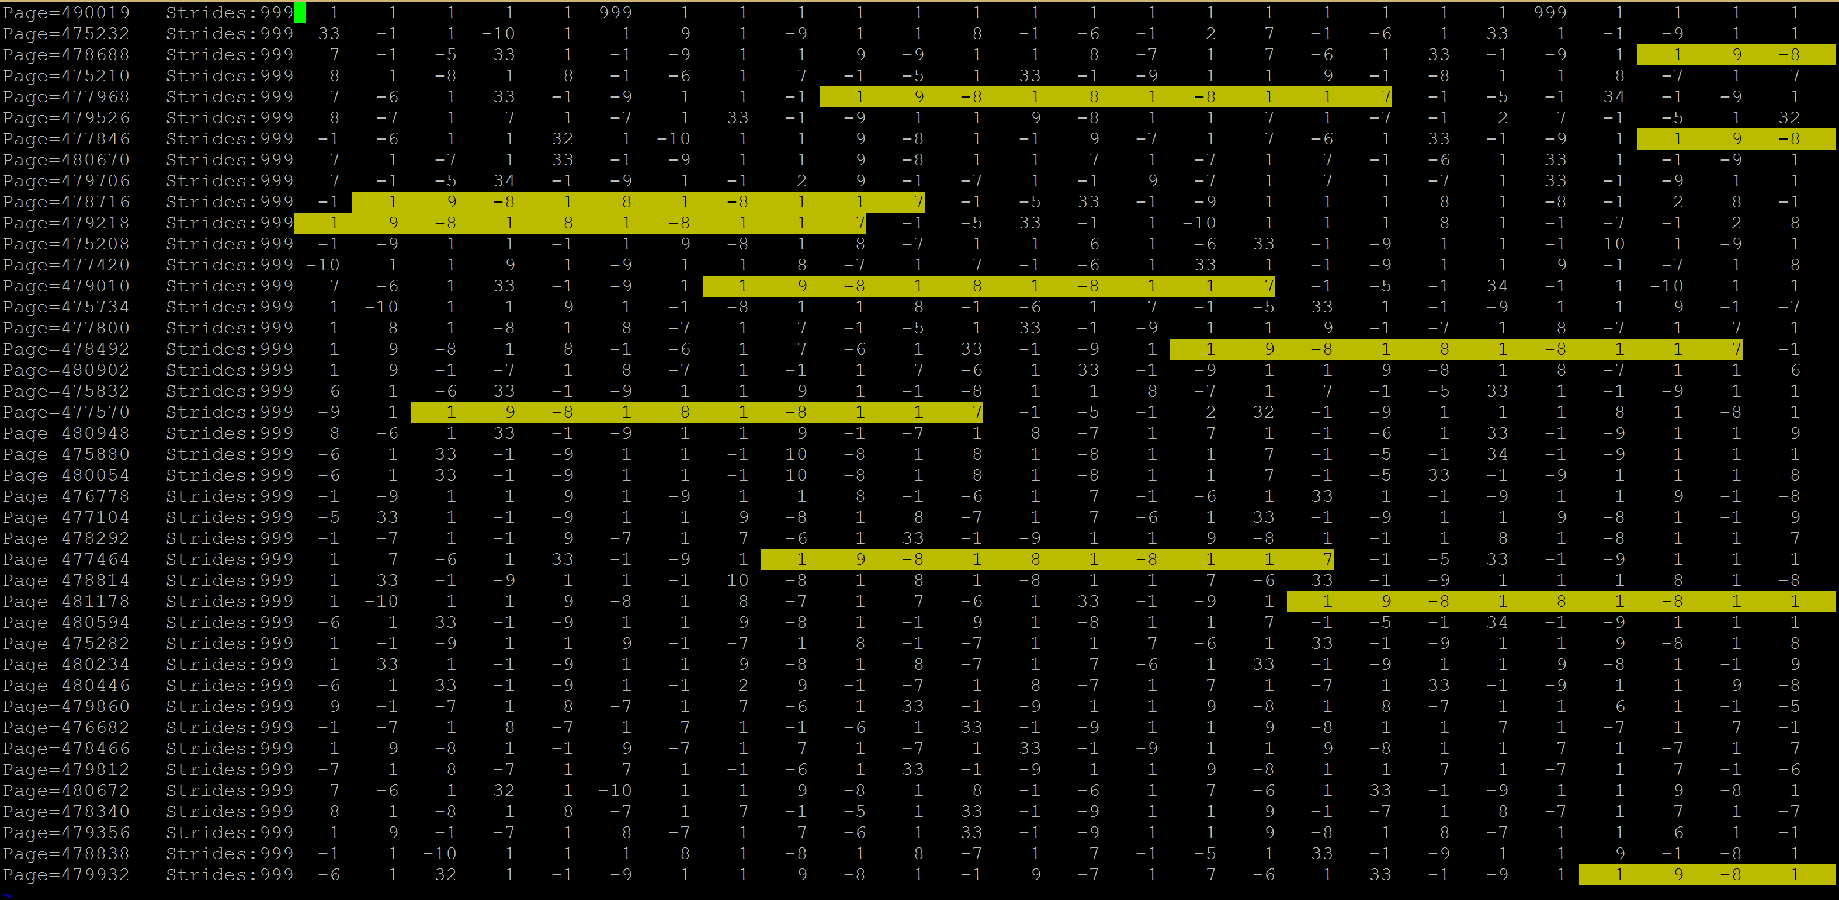
Long Repeatable Streams of Irregular Deltas
Delta patterns for milc
Repeating Delta Pattern : (1, 9, -8, 1, 8, 1, -8, 1, 1, 7), (1, 9, -8 ……..
Notes:
So the question is How often do they occur?
This slide shows the Delta patterns for different pages of the milc benchmark from SPEC2006. On the left side, is the page number and these number on the rest of the slide are the Deltas
I don’t expect you to read the screen shot on this slide, but what we do see here is that this pattern repeats over and over

Slide 5
Long Repeatable Streams of Irregular Deltas
Deltas : 1, 9, -8, 1, 8, 1, -8, 1, 1, 7, -1, -5,…..
Cache Line: A+1, A+10, A+2, A+3, A+11, A+12, A+4, A+5, A+6, A+13, A+12, A+7……
Stream 1 : A+1, A+2, A+ 3, A+4, A+5, A+6, A+7
Stream2: A+10, A+11, A+12, A+13
Stride Prefetcher
Coverage: 5/11
Confirmation
Prefetches
SandBox Prefetcher
Coverage: 9/11
Notes:
So how would stream prefetchers handle this….
But this is one stream. A stream that repeats very often. Ideally a correlating prefetcher should be able to predict A+10 because it is part of the same repeating pattern.

Slide 6
Motivation
No stream confirmation needed
Precise control over predictions
Low area overhead
Predict Irregular Delta Patterns
Notes:
Keeping all this in mind, The goal of this work was to build
a prefetcher that can quickly recognize patterns
Has precise control over what to prefetch. Unlike other prefetchers which probabaistically make predictions, leading to several predictions for a single cache miss.
Often, prefetchers have a tendency to run too far ahead of the stream. Works like the FDP have shown that this is can lead to bad performance.
Has low area and complexity overhead
Can identify streams with irregular repeatable stride strides

Slide 7
Variable Length Delta Prefetcher
Notes:
So with these objectives in mind, we present the Variable Length Delat Prefetcher.
So let’s dive deep and go through the details of the this prefetcher.

Slide 8
Prediction Mechanism
Predicted
Delta
Core 1
+
L1
Per Page
Delta History
Tables
Delta/Offset Prediction Tables
L2 Access
L2 Cache
Structure of VLDP- Prediction Mechanism
Notes:
The prefetcher can be split into tow parts. A book keeping part and the prediction part
VLDP relies entirely on Delta patterns to make predictions and issue prefetches.
Resides with the LLC
No PC information No Virtual Address is available
The Prediction Mechanism is made up of two parts, The book keeping part and the the acutal brains of the prefetcher
The brains of the Prefetcher is in the Prediction tables, later we will see if we can use this framework and just tewak

Slide 9
Delta History Buffer
for (i=0;i<BIGNUM; i++)
{
a[i]=b[i]+c[i];
}
a, b, c can each belong to different pages
So Deltas between pages is meaningless
Delta = Last Address- Current Address
Page Num.
Last
Add.
Last 3 Deltas
Num
Used
Page Num.
Last
Add.
Last 3 Deltas
Num
Used
Page Num.
Last
Add.
Last 3 Deltas
Num
Used
Page Num.
Last
Add.
Last 3 Deltas
Num
Used
35Bits 7Bits 24Bits 2Bits
Total of 68Bits/page tracked
Notes:
Make the size of the page bits fewer

Slide 10
Delta Prediction Tables
Lowest Priority (t=1)
Highest Priority (t=3)
Delta(1) | Pred. | Accuracy
8 b | 8 b | 2 b
Deltas (3) |  |  | Pred. | Accuracy
8b | 8b | 8b | 8b | 2b
64 Rows per Table
…
Match?
Match?
MUX
Predicted Delta
Notes:
DPT are a series of cascaded tables which have predictions for different number of deltas available
Ideally we would like to make predictions with the most information available. But if the page has not been accessed less than 4 times, there will not be 3 deltas.
When the patterns are less than 3 deltas long, then we will have to look in the tables which tracks shorter deltas.
Any time the DPT is looked up, there can be hits in multiple tables. Only the prediction from the longest delta sequence is used as the prediction.

Slide 11
Need for Multiple Tables
Repeating Delta Pattern- 1, 2, 3, 5, 2, 4
Table 1
Table 2
Delta | Pred.
1 | 2
2 | 3
3 | 5
5 | 2
Delta | Pred.
1,2 | 3
2,3 | 5
3,5 | 2
5,2 | 4
100% Accuracy
50% Accuracy
100% Accuracy
Search for Delta pattern match starts from right most table
Notes:
Which is why the search for delta patterns starts from right most table.
When more deltas are present, there is higher chance the prediction is right.

Slide 12
Looking farther than one Delta ahead
Repeating Delta Pattern- 1, 2, 3, 1, 2, 3…….
Current Delta
Delta | Pred.
1 | 2
2 | 3
3 | 1
- | -
Delta | Pred.
1,2 | 3
2,3 | 1
3,1 | 2
-,- | -
Degree 1 Prediction

Slide 13
Looking farther than one Delta ahead
Repeating Delta Pattern- 1, 2, 3, 1, 2, 3…….
Current Delta
Deg 1 Prediction
Delta | Pred.
1 | 2
2 | 3
3 | 1
- | -
Delta | Pred.
1,2 | 3
2,3 | 1
3,1 | 2
-,- | -
Degree 2 Prediction
Degree 1 Prediction
Use Recursive lookup to look farther than one Delta

Slide 14
Case Study: Streaming Workloads
Repeating Delta Pattern- 1, 1, 1, 1, 1…
Table 1
Table 2
Delta | Pred.
1 | 1
- | -
- | -
- | -
Delta | Pred.
1,1 | 1
-,- | -
-,- | -
-,- | -
Regular Delta Patterns are dealt with very efficiently
Notes:
We saw how VLDP works for heterogeneous deltas. Now lets see how it works for Homogeneous slides

Slide 15
How to Issue Prefetches?
L1 Cache
L1 Cache Miss
L2
Cache
Update Delta History Buffer
Update Delta Prediction Tables
Issue Prediction
L2 Access

Slide 16
Updating the Delta History Tables
If Page not present, replace
Page Num.
Last
Add.
Last 3 Deltas
Num
Used
L2 Cache Access
Page Num.
Last
Add.
Last 3 Deltas
Num
Used
If Page present, add Delta
Page Num.
Last
Add.
Last 3 Deltas
Num
Used
FIFO

Slide 17
Updating the Prediction Tables
Page Num.
Last
Add.
Last 3 Deltas
Can the current state predict
Latest Delta?
B, C, D
E
If Prediction is Correct
Increment Accuracy
If Prediction of Wrong
Decrement Accuracy
If Accuracy==0
Update Prediction
If Prediction is Missing
Seed T1 with prediction
Latest Delta
Delta | Pred.
B | E?
- | -
- | -
- | -
Delta | Pred.
B,C | E?
- | -
- | -
- | -
Delta | Pred.
B,C,D | E?
- | -
- | -
- | -
Table 1
Table 2
Table 3

Slide 18
Populating the Prediction Tables
Delta | Pred.
1 | A
- | -
- | -
- | -
Delta | Pred.
1,1 | B
-,- | -
-,- | -
-,- | -
Delta | Pred.
1,1,1 | C
- | -
- | -
- | -
Table 1
Table 2
Table 3
Table 1
Wrong
Table 2
Wrong
FIFO
FIFO
FIFO
If mis-predict, a longer Delta history might be needed

Slide 19
Need for throttling
Time
P1
B1/R1
P2
B1/R2
Demand Requests
P1
B1/R1
P1
B1/R1
P1
B1/R1
P1
B1/R1
P1
B1/R1
P1
B1/R1
P1
B1/R1
Prefetch Requests
P2
B1/R2
P2
B1/R2
P1
B1/R1
P1
B1/R1
P1
B1/R1
P1
B1/R1
P1
B1/R1
P1
B1/R1
P1
B1/R1
P1
B1/R1
P2
B1/R2
P2
B1/R2
P2
B1/R2
Service Order With FR-FCFS Scheduling
Notes:
Papers like FDP and Minimalist open page have shown that very aggressive prefetching can have detrimental effects on the performance.
This is especially important when the DRAM scheduling policy is not aware of the distinction between prefetch requests and demand requests.
The FR-FCFS scheduling policy tries to maximize throughput at the cost of fairness. It prioritizes RBH over RBMisses.
This can lead to situations where even if the prefetcher able to accurately predict every access in a page, it can lead to bad performance.
Imagine a situation where two pages that are
Because most prefetchers are only able to issue prefetches within a page. Most prefetch requests end up becoming hits.
If there happens to be another request going to a different row in the same bank. Then

Slide 20
Prediction Mechanism
Throttling Mechanism
Issue Prefetch
Predicted
Delta
Per Page
Delta History
Tables
Delta/Offset Prediction Tables
Prefetch Queue
Core 1
L2 Cache
Virtual DRAM Read Queue
Queue Occupancy
Structure of VLDP
Notes:
We introduce a throttling mechanism into VLDP.
The throttling mechanism keeps track the prefetch as well as demand requests that are currently being serviced my memory.
It limits the number of PF requests are are sent to any bank and hence when a demand request is sent, it does not have to wait for a long time in the queue.

Slide 21
Evaluation Methodology
Evaluated using DPC2Sim
11 workloads from the SPEC2K6 benchmark suite
1 Billion instructions simulated after fast-forwarding by 10B instructions
VLDP Configuration
3 Delta Prediction Tables used
64 entry Offset Prediction Table
64 entry Delta Prediction Table
128 pages tracked in Delta History Buffer
Prefetches up to 4th degree were issued

Slide 22
Performance Improvement

Slide 23
Demand Miss Latency
Notes:
The L2 miss latency is a function of L3 hit rate, DRAM row
buffer hit rate and the queuing delay at the memory controller.
VLDP and AMPM prefetch to the L3 cache, when the L2 read
VLDP reduces L2 read miss latency by 3%

Slide 24
Prefetch Latency
Notes:
Prefetch Latency reduces by 89%

Slide 25
Thank You

Slide 26
Updating the Prediction Tables
Deltas: A, B, C, B, D
C
A, B
C
B
D
C, B
D
Notes:
When there is a mispredict, looking into the histo

Slide 27
Delta Stream: (A B C D E F), (A B C D E F)
L2 Access
Degree 1-4 Predictions
Incorrect
Prediction
A
Prediction
B C X E
Accuracy(A)++
B
Prediction
C X E F
Accuracy(B)++
C
Prediction
X E F A
Accuracy(C)--
D
Prediction
E F A B
Multi Degree Prefetch Example
Notes:
It is important to note that the predicted stream is 4 steps ahead, but each time only one prefetch is used.

