Slide 1
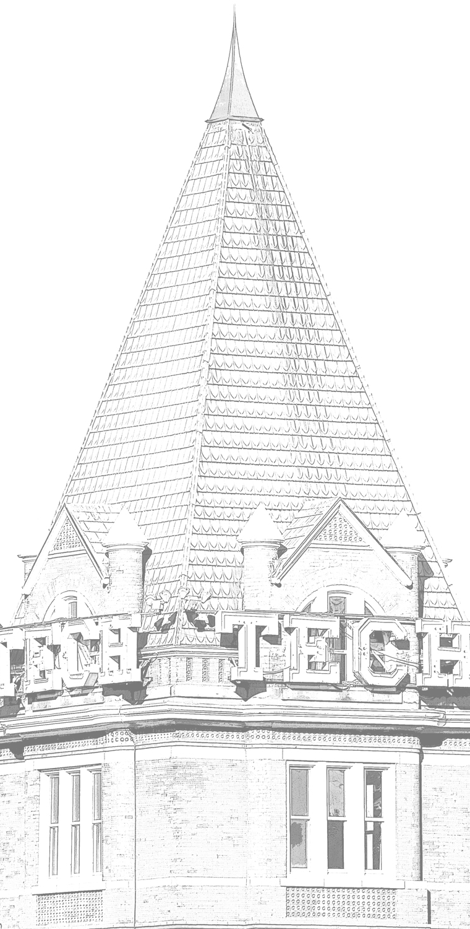
Towards Bandwidth-efficient prefetching with slim ampm
June 13th 2015
DPC-2 Workshop, ISCA-42 Portland, OR
Vinson Young
Ajit Krisshna
Notes:
Good morning, I will be talking about “Towards Bandwidth-Efficient Prefetching with Slim AMPM”
I am Vinson Young.
This work is in collaboration with my classmate and co-author Ajit Krisshna.

Slide 2
Executive Summary
Prefetching less can be beneficial
Prefetching consumes additional bandwidth
Prefetching causes cache pollution
Slim AMPM: case study in reducing BW and pollution
3 Techniques for efficient bandwidth consumption
1 Technique for reducing cache pollution
Method: Co-design best prefetchers with BW in mind
Result: Slim AMPM nearly 4% speedup over AMPM, for multiple configurations
Notes:
Conventional knowledge says the more types of prefetching you do, the better.
But what we’ve found, is, that, often, prefetching less, can improve performance.
This is because prefetching is expensive. It consumes additional on-chip bandwidth, and additionally pollutes caches with prefetches.
To this end, we propose Slim AMPM, a case study in showing how reducing bandwidth and pollution overhead can improvement performance.
We show 3 techniques for more efficienct bandwidth consumption, and 1 for reducing cache pollution.
We show that by co-designing best prefetchers, with bw in mind, we can get nearly 4% speedup over AMPM, for multiple configurations.
We hope through this work future prefetchers will design with bandwidth and cache pollution in mind.

Slide 3
outline
Introduction to bandwidth and cache pollution
3 Bandwidth Optimizations
1 Cache Pollution Optimization
Slim AMPM
Results
Summary
Notes:
First, our bandwidth optimizations.

Slide 4
Prefetch uses on-chip Bandwidth
Prefetching causes MSHR contention with reads
Prefetches can fill MSHR, stalling pipeline
Cannot continue if MSHR full
Demand
D
D
D
L2 MSHR
D
P
P
P
D
P
P
P
Prefetching should take bandwidth into account
Notes:
Prefetchers send requests to the same MSHR as demand requests do.
Sending ^a lot of prefetch requests can delay reads and fill MSHR, causing processor to stall.
As such, intelligent prefetchers should also take into account bandwidth consumption.

Slide 5
Optimize for Bandwidth
1. Co-design of regular and irregular prefetching
Optimize AMPM + DCPT, for bandwidth
2. Bandwidth throttling / smoothing
Optimize number of prefetches sent
3. Dynamic L2 or L3 prefetch
Optimize prefetch into L2 or L3
Frugal prefetching reduces bandwidth overhead
Notes:
Our first optimization co-designs leading prefetchers, in the face of bandwidth consumption.
The other two^ are also designed with the thought, that, being frugal with prefetch requests can improve performance.

Slide 6
Hybrid prefetcher for coverage
Idea:
Query more prefetchers for higher coverage
Method: Combine regular + irregular prefetcher
Regular pattern prefetcher (AMPM)
Irregular pattern prefetcher (DCPT)
Benefit:
High coverage across wide set of workloads
Hybrid prefetcher for coverage
Notes:
So, the idea is that by querying more prefetchers, we can have more coverage for a variety of workloads.
Here ^, we combine a regular pattern prefetcher, AMPM, and an irregular pattern prefetcher, DCPT.
^With this we should have higher coverage. But what happens in the face of additional bandwidth consumption? To be answered shortly.

Slide 7
Prefetching Regular PATTERNS
Regular access patterns
Stream, Stride, Address Map Pattern Matching
Address Map Pattern Matching (AMPM)
Per-page “Access map”
Finds streams based previously accessed lines
Tracks 32-512 hot pages
Line prefetched
Lines previously accessed
Line just accessed
Page 0
A
xx
A
xx
Cur
xx
xx
P
xx
xx
Use AMPM to prefetch regular accesses
Notes:
First, we explain our choice in AMPM.
Regular pattern prefetchers usually prefetch by detecting streams or strided patterns, with accesses like N, N+2, N+4 …
^We choose the current best-performing prefetcher, Address Map Pattern Matching.
AMPM works by keeping track of cache lines already accessed^ within a page, seeing the ^current access, and then simultaneously ^checking for all likely strides.
AMPM keeps an access history by keeping a bitmap for several hot, or frequently accessed, pages. We call these bitmaps “access maps.” We keep track of 32-512 of these hot pages at a time.
^AMPM is effective in prefetching regular accesses, but it performs badly with irregular patterns, such as pointer chasing.
How do we prefetch irregular patterns?

Slide 8
PREFETCHing IRREGULAR PATTERNS
PC-based prefetching
Irregular Stream Buffer (Prefetch temporal patterns)
PC / Delta-correlating (Prefetch pc-based pattern)
Delta-Correlating Prediction Tables (DCPT)
PC | delta | delta | delta | … | last access
DCPT Example
Address: 10 11 20 21 30
Deltas: 1 9 1 9
Prefetch: 31 40 ….
Use DCPT to prefetch irregular access patterns
Notes:
We can prefetch irregular patterns by keeping track of PC-based access history.
Here are a couple examples.
PC / DC keeps track of the access history of certain PC’s to guide its prefetching.
And Delta-correlating prediction tables (DCPT) is a space-efficient variant that stores access history by only storing differences. We use DCPT as it is space-efficient and able to prefetch irregular patterns.
DCPT, for example, can prefetch along odd patterns like this. 10, 11, 20, 21, 30.
Here, the deltas are just 1 9, and then 1 9 again.
DCPT is able to continue prefetching in this pattern whereas AMPM would not.
But, what happens when we use both AMPM and DCPT at the same time?

Slide 9
AMPM + DCPT wastes bandwidth
AMPM for regular patterns, DCPT for irregular patterns
But, using both simultaneously wastes bandwidth
Must combine AMPM+DCPT in bw-efficient manner
Notes:
… Performance is actually degraded! …relative to AMPM.
Here, the y axis shows % speedup normalized to AMP. And the x axis shows various configurations. These are the baseline configuration, small LLC…, low bandwidth.., and configuration with randomized access stream.
As you will note, we actually have a ~0.1% performance degradation from using both policies at once.
This is because although we get more coverage, their combined bandwidth consumption actually cause slowdown on a whole.
We must combine them in a bandwidth-efficient manner.

Slide 10
1. Co-design AMPM + DCPT
start
Switch between AMPM or DCPT
Can DCPT Prefetch?
yes
no
DCPT
AMPM
Issue prefetch
Issue prefetch
Update prefetch parameters
DCPT then AMPM to reduce AMPM over-prefetching
Notes:
To combine them without wasting bandwidth, we can simply switch between using the policies.
Here, if DCPT has candidate prefetches, the workload is more likely to be accessing memory irregularly so we prefetch using DCPT. As such, we do not waste bandwidth on attempting to prefetch strides using AMPM.
If DCPT cannot predict access pattern, we default to using AMPM as it provides good prefetches regardless.
This lets us prefetch both regular and irregular patterns, without over-prefetching in either access pattern.

Slide 11
HYBRID AMPM + DCPT performance
Hybrid AMPM+DCPT improves performance by .5%
Notes:
Switching between the policies overall gives us a performance improvement of .5%, over AMPM, as it stops AMPM from over-prefetching in the case of irregular accesses.

Slide 12
Optimize for Bandwidth
1. Co-design of regular and irregular prefetching
Optimize AMPM + DCPT, for bandwidth
2. Bandwidth throttling / smoothing
Optimize number of prefetches sent
3. Dynamic L2 or L3 prefetch
Optimize prefetch into L2 or L3
Notes:
Our 2nd technique works by purely smoothing / reducing the number of prefetches sent out to reduce L2 MSHR contention.

Slide 13
WHY Bandwidth Throttle / Smooth
Idea: Limit # prefetches to reduce BW consumption
Reducing prefetches reduces L2 MSHR stall
Demand
D
D
D
No stall!
L2 MSHR
D
P
D
P
R
P
P
P
Reduce bandwidth overhead by limiting prefetches
Notes:
The idea is that by reducing prefetches, L2 MSHR is less likely to be stalled and demand requests are more likely to be fulfilled in a timely manner.

Slide 14
2. Bandwidth Throttle / Smooth
AMPM:
Reduce candidate strides to 1, 2, 3, 4
Reduce max AMPM prefetches to 2
Benefits:
Reduces bandwidth consumption
Smooths bursty bandwidth
Slim down AMPM to reduce bandwidth consumption
Notes:
To reduce prefetches in our configuration, we reduce the strides AMPM checks to only the most accurate to strides of 1, 2, 3, 4, and sometimes 6. We also reduce maximum number of prefetches AMPM can send at once to 2, to make sure prefetches are not bursty.
This reduces bandwidth consumption overall and reduces the likelihood of a burst of prefetches filling L2 MSHR and causing a stall.

Slide 15
Bandwidth smoothing results
Smoothing bandwidth gives 1.1% speedup
Notes:
Reducing and smoothing prefetcher bandwidth consumption gives us a consistent 1.1% speedup across multiple configurations, over our hybrid AMPM+DCPT.

Slide 16
Optimize for Bandwidth
1. Co-design of regular and irregular prefetching
Optimize AMPM + DCPT, for bandwidth
2. Bandwidth throttling / smoothing
Optimize number of prefetches sent
3. Dynamic L2 or L3 prefetch
Optimize prefetch into L2 or L3
Notes:
Our third technique relies on offloading prefetches to L3 such that L2 MSHR will be less likely to fill.

Slide 17
Prefetch to l3 can reduce l2 load
Idea: Reduce load on L2 by prefetching more to L3
Offload prefetch to L3 when L2 in use
Demand
D
D
D
D
No stall!
D
L2 MSHR
D
P
D
P
D
P
P
P
P
P
P
L3 MSHR
D
P
R
P
R
P
P
P
Prefetch to L3 to reduce L2 MSHR stalls
Notes:
Here, if we prefetch into L3, we can reduce the chance of filling L2 MSHR queue, reducing the chance of L2 MSHR stall.

Slide 18
3. L3 prefetch implementation
AMPM:
Prefetch into L3 by default
Prefetch to L2 only when L2 not in use
i.e. when L2 has high MPKI, low hit rate
Benefits:
Reduced L2 load
Opportunistically use L2 when free
Prefetch into L3, and into L2 when L2 not in use
Notes:
In the context of AMPM:
We simply prefetch into L3 by default, and only prefetch into L2 when L2 is not in use.
What we mean by “not-in-use” is the case when L2 has high MPKI and low hit rate, essentially not providing us benefit anyways.
What this offers us is reduced L2 bandwidth consumption, and ability to use L2 when it is not useful.

Slide 19
L3 Prefetch results
L2/L3 prefetching improves performance by 0.5%
Notes:
Prefetching into L3 for the most part gives us performance improvement of 0.5%, over hybrid AMPM, across multiple configurations.

Slide 20
outline
Introduction to bandwidth and cache pollution
3 Bandwidth Optimizations
1 Cache Pollution Optimization
Slim AMPM
Results
Summary
Notes:
Next, cache pollution

Slide 21
Prefetch causes Cache Pollution
Prefetching into caches evicts previous entry
Reduce pollution with:
less wasted prefetches
more accurate access maps
Prefetch 0x10
Demand 0x00
Demand 0x00
Demand 0x01
Prefetch can evict useful entries
Prefetchers should take cache pollution into account
Notes:
Prefetching also causes cache pollution, where cache becomes filled with prefetches, and useful lines cannot be cached well.
We can reduce cache pollution by wasting less prefetches, or ..
If we can better understand what is inside cache, we can better decide when to prefetch.
What do we mean by more accurate access maps? Well let us first talk about issues with current AMPM “access map”.

Slide 22
POLLUTION via Stale ACCESS map
Bad prefetch sent
Wasted prefetch
Stale accesses
Line just accessed
Over-Prefetch
~A
~A
~A
xx
Cur
xx
xx
P
xx
~A
Good prefetch not sent
Not prefetched
Previous accesses
Line just accessed
Under-Prefetch
A
xx
A
xx
Cur
~A
xx
P
~A
xx
No longer in cache
Prefetcher less effective with stale maps
Notes:
Here, we touch upon the case of pollution via Stale access map.
“what does stale access map mean?” It means the access history is no longer relevant to your current execution flow.
Here, yellow corresponding to lines no longer in cache, we can see AMPM overprefetch from seeing streams that are artifacts of old accesses, polluting our cache.
Additionally, if history is stale… it can also not send useful prefetches, as AMPM believes the prefetch has already been brought in.
We should design AMPM such that its access maps are up-to-date.

Slide 23
Stale maps reduce performance
More access maps don’t always improve prefetching
Tracking too many pages can cause map to go stale
AMPM “access maps” should be adjusted
Notes:
Here, we take a closer look at AMPM’s number of “access maps” it keeps.
Our first instinct was, that, keeping access maps for every page accessed would better guide prefetches.
But, we found that increasing access maps arbitrarily actually doesn’t always improve prefetching.
Here, we show benchmark MCF’s IPC, with respect to number of pages tracked.
Performance actually decreases after a certain number of pages.
This shows that keeping track of too many “access maps,” actually makes “access maps” unable to evicted and refreshed, and become stale.
Ideally, we need a little bit of refresh.

Slide 24
Refresh “Access maps” ➔ lower pollution
Idea:
Refresh access maps periodically and dynamically
Benefits:
“Access Map” up-to-date for informed prefetches
“Access Map” refresh dynamically to fit workloads
Dynamically refresh to reduce stale “access maps”
Notes:
Here, our idea is to refresh “access maps” periodically, and dynamically, for more up-to-date access history.
This allows us to have more informed prefetches. And we can refresh dynamically to better fit different workloads.
Thus, we should dynamically refresh “access maps.”

Slide 25
Refresh Implementation
AMPM:
“Access map” use random eviction 1% of time
Dynamically reduce number of “access maps” for workloads that miss “access maps” often
Benefits
Periodic refresh
Fewer “access maps”➔ quickly adapt to workload
Dynamically refresh “access maps”
Notes:
To do so, we use random eviction 1% of the time, instead of LRU.
And then we dynamically reduce number of “access maps” for workloads that miss “access maps” often.
This allows the maps to refresh, and it allows “access maps” to more quickly adapt to workloads that change patterns quickly.

Slide 26
“Access map” refresh performance
“Access map” refresh improves performance by .9%
Notes:
Refreshing “access maps” gives us a speedup of .9% on average over hybrid AMPM.

Slide 27
outline
Introduction to bandwidth and cache pollution
3 Bandwidth Optimizations
1 Cache Pollution Optimization
Slim AMPM
Results
Summary
Notes:
Now, our Slim AMPM

Slide 28
Slim AMPM
Bandwidth Optimizations
Hybrid AMPM+DCPT
Bandwidth throttle / smoothing
Dynamic L2 or L3 prefetch
Cache pollution Optimizations
“Access Map” refresh
BW-efficient Slim AMPM for improved performance
Notes:
Our proposal, Slim AMPM, is the combination of all the aforementioned optimizations:
3 bandwidth optimizations, of hybrid AMPM+DCPT, bandwidth throttling, and L3 prefetch
And
1 bandwidth optimization of “access map” refresh.
This gives us hybrid AMPM+DCPT, highly tuned to reduce negative prefetching effects of bandwidth consumption and cache pollution.

Slide 29
Parameters
Read the paper!
Slim AMPM | Parameter | Configuration
AMPM | # pages | 512, dynamically decrease
 | Replacement | LRU 99%, Random 1%
 | Candidate Prefetch | -4 to 4
 | Max prefetches | 2, or 1 for low bw
 | Prefetch to L2/LLC | Dynamic, based on L2 hit %
DCPT | DCPT Entries | 200
 | Number deltas | 9
 | Prefetch to L2/LLC | Dynamic, based on L2
 | Max Prefetches | 4, or 3 for low bw
Slim AMPM parameters tuned for BW
Notes:
Our Slim AMPM uses tracks 512 pages (2MB span), and dynamically decreases them to better suit workloads.
Our other configurations are as mentioned before, but if you want more time to look at them, I point you to our paper ☺.
Anyways, Slim AMPM is highly tuned for bandwidth reduction.

Slide 30
outline
Introduction to bandwidth and cache pollution
3 Bandwidth Optimizations
1 Cache Pollution Optimization
Slim AMPM
Results
Summary
Notes:
Now, results

Slide 31
Testing framework
DPC-2 setup:
L1(16KB) / L2(128KB) / L3(1MB) / Main mem
Benchmarks: 8 High MPKI workloads from SPEC2006
Configuration | L3 size | Memory BW
Base | 1MB | 12.8 GB/s
Small LLC | 256KB | 12.8 GB/s
Low BW | 1MB | 3.2 GB/s
Random | 1MB | 12.8 GB/s
Verified on multiple configurations and benchmarks
Notes:
We use the DPC-2 framework to verify our results:
DPC-2 uses a memory hierarchy with 16KB L1, 128KB L2, 1MB LLC, prefetching from Main memory.
We run the prefetchers on 4 separate configurations, base, small LLC, low BW, and randomized memory stream.
The prefetchers are run on 8 high MPKI workloads from SPEC2006. We warm-up for 100million instructions before running rest of provided traces. We also tested on longer traces and found that our optimizations are effective.
I’ll first discuss a little about our configuration as I will be showing results through the explanation.
We used the DPC-2 framework, with 16KB L1, 128KB L2, and 1MB L3 size, to main memory.
We have 4 configurations, first is baseline as previously stated, small last-level cache, one with low bandwidth, and the last one with slightly scrambled memory accesses.
For verification, we have used 8 high MPKI workloads from SPEC2006 benchmark suite.

Slide 32
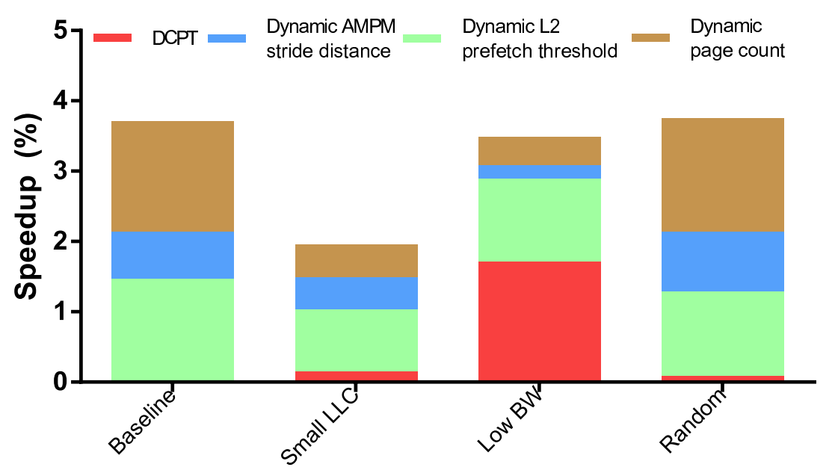
% SPEEDUP over ampm
Slim AMPM has speedup of 3.3% over AMPM
Notes:
Here, we show the % speedup “Slim AMPM” has over baseline “AMPM,” with the breakdown showing how much each individual component contributes to the speedup.
For 3 of the configurations, Slim AMPM achieves almost 4% speedup. Overall, Slim AMPM achieved a speedup of 3.3% over AMPM

Slide 33
% SPEEDUP over no prefetch
Slim AMPM
AMPM
Slim AMPM has speedup of 19.3% over no prefetch
Notes:
Here, we show the % speedup over no prefetching. We show the results for both Slim AMPM and AMPM.
Slim AMPM has a speedup of 19.3% over no prefetch, whereas AMPM has speedup of 15.7% over no prefetching.

Slide 34
outline
Introduction to bandwidth and cache pollution
3 Bandwidth Optimizations
1 Cache Pollution Optimization
Slim AMPM
Results
Summary
Notes:
In summary,

Slide 35
Executive Summary
Prefetching less can be beneficial
Prefetching consumes additional bandwidth
Prefetching causes cache pollution
Slim AMPM: case study in reducing BW and pollution
3 Techniques for efficient bandwidth consumption
1 Technique for reducing cache pollution
Method: Co-design best prefetchers with BW in mind
Result: Slim AMPM nearly 4% speedup over AMPM, for multiple configurations
Notes:
We’ve found that over the course of our experiments, prefetching less, can improve performance.
This is because prefetching is expensive. It consumes additional on-chip bandwidth, and additionally pollutes cache with prefetches.
To this end, we propose Slim AMPM, a case study in showing how reducing bandwidth and pollution overhead can improvement performance.
We show 3 techniques for more efficienct bandwidth consumption, and 1 for reducing cache pollution.
We show that by co-designing best prefetchers, with bw in mind, we can get nearly 4% speedup over AMPM, for multiple configurations.

Slide 36
Thank you
Notes:
That brings me to the end of my presentation. Thank you for your attention. I'd be glad to answer any questions you might have.
We would like to acknowledge Prashant Nair, for his help in this work.
And also advisor Moinuddin Qureshi and labmate Swamit Tannu.

